Slide 1
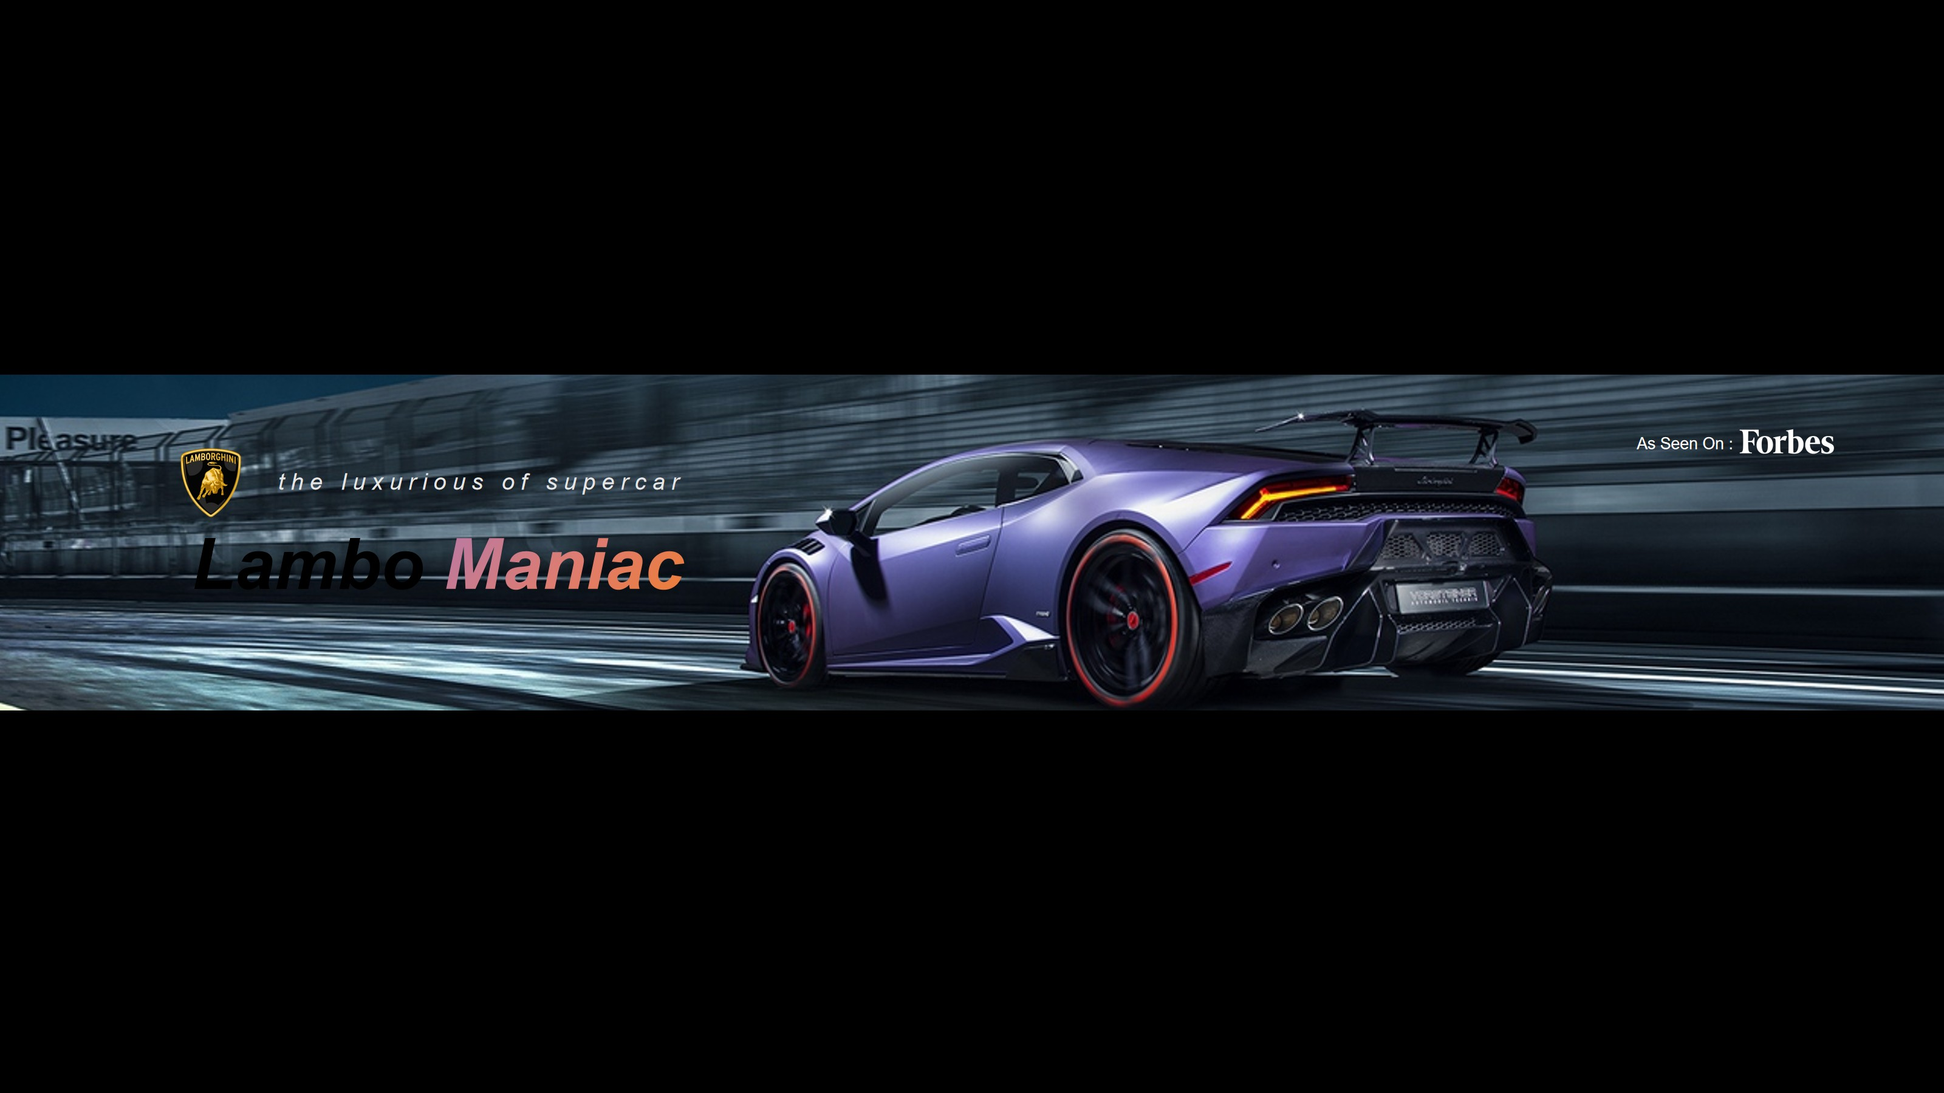

A Premium Portfolio Designed to Stand Out on LinkedIn
Modern, elegant & industry-ready personal portfolio
Built with advanced UI/UX, animations & interactive elements
LinkedIn
2026
Rajeev Dataverse

Slide 2


Slide 3
A Premium Portfolio Designed to Stand Out on LinkedIn
Modern, elegant & industry-ready personal portfolio
Built with advanced UI/UX, animations & interactive elements
Designed to impress recruiters and LinkedIn connections
Focuses on storytelling and professional branding
Combines aesthetics with functional design
Ideal for learners and working professionals

Slide 4

Project Overview
Project Overview
01
04
Premium personal portfolio to represent professionals online
Creates a strong digital identity for personal branding
02
05
Goes beyond resumes & LinkedIn profiles
Combines clean design, smooth animations, and interactive logic
03
06
Focuses on credibility, visual storytelling, and modern web interaction
Enhances professional visibility and engagement

Slide 5
Purpose of This Website
Purpose of This Website
A
01
Designed for LinkedIn connections & beginner professionals
Helps users without their personal website
B
02
Acts as a digital identity and trust-building platform
Makes self-representation easy, modern, and visually impactful
C
03
Supports professional growth and credibility building
Encourages users to showcase real skills confidently

Slide 6
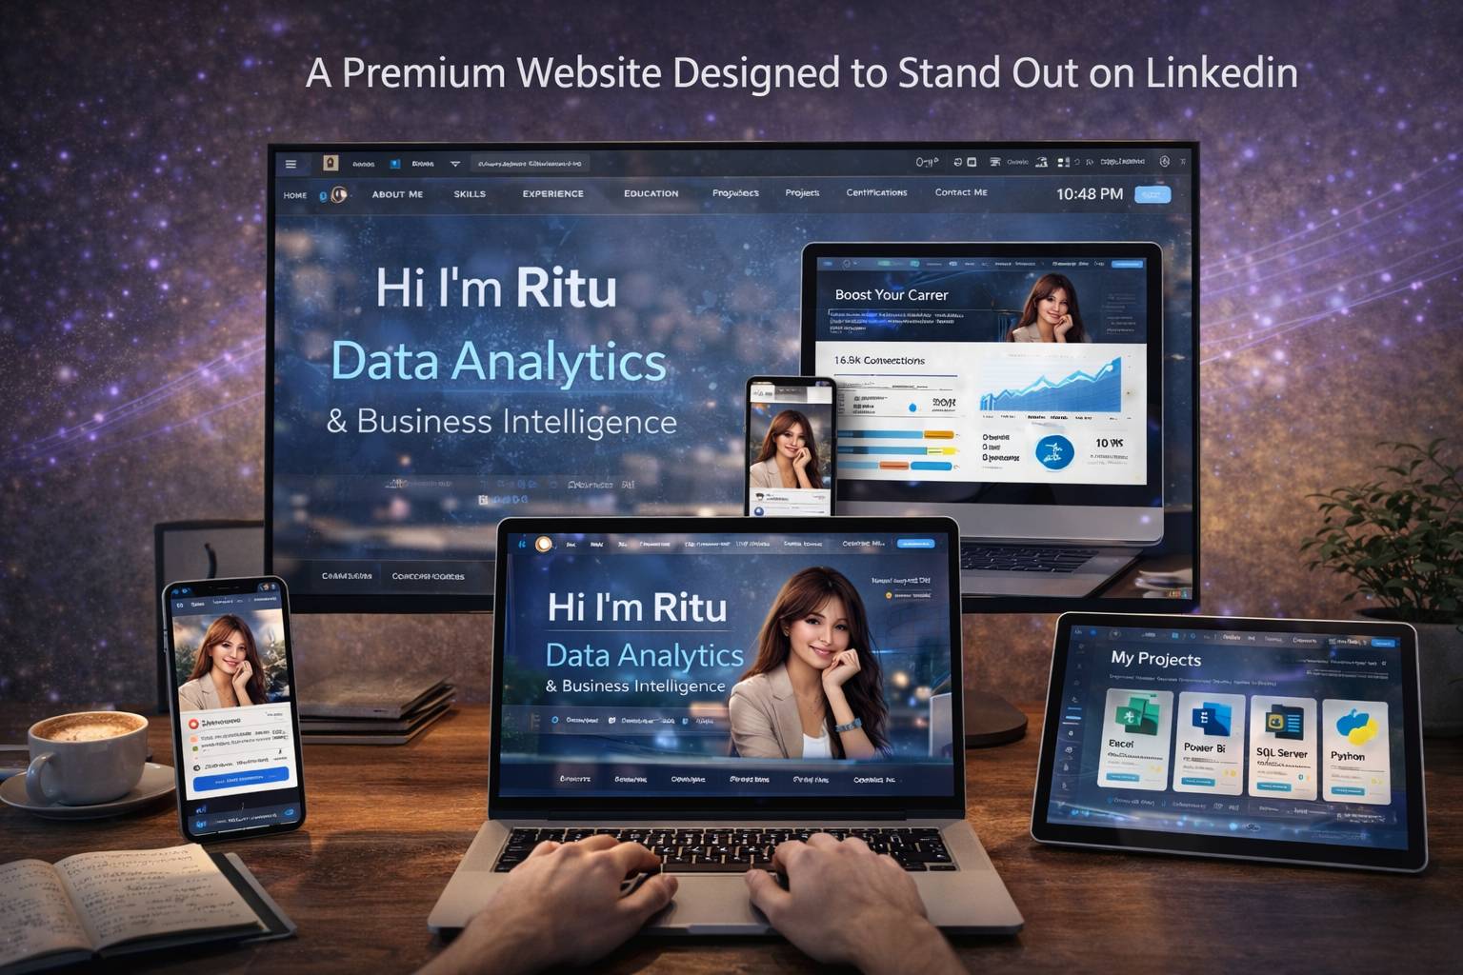


Motive & Vision
Motive & Vision
Enable effective personal branding and recognition
Encourage interactive and visually appealing presentation
02
04
Convert skills into visible credibility and reputation
Bridge the gap between learning and showcasing skills
01
03
Help learners & professionals stand out professionally
Provide a professional presence with zero complexity

Slide 7
Target Audience
Who Can Benfit
08/10
Data Analysts, Data Scientists, Data Engineers
AI / ML Engineers, DevOps Engineers, and IT professionals
Working professionals & serious learners wanting recognition
LinkedIn profile enhancement and personal branding
Job and internship applications visibility
Freelance identity and project showcase
Portfolio for skill demonstration and credibility building
Resume support with interactive online representation
Rajeev Dataverse

Slide 8
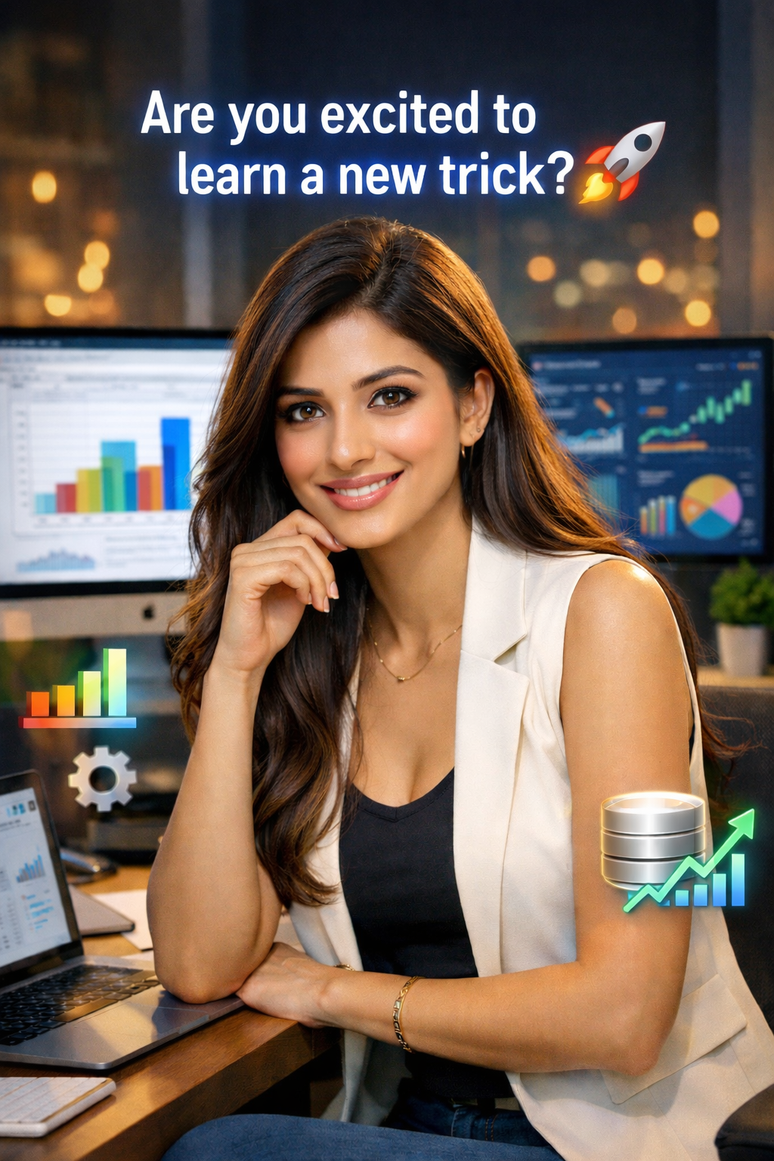

Importance of This Portfolio
Why This Matters
LinkedIn profiles alone are limited in representation
Recruiters prefer visually credible online portfolios
Personal websites increase trust and professional credibility
Helps beginners compete professionally with established profiles
Supports skill demonstration beyond text resumes
Creates a strong first impression on viewers
LinkedIn

Slide 9

Overview
Website Structure Overview
Hero Section with dynamic visuals
About Me section with interactive storytelling
Skills section with professional representation
Experience section highlighting real work
Projects, Certifications, Contact Me, and Footer
Each section designed for clarity, flow, and storytelling
4k
120p
600 Mbps
AI

Slide 10


Hero Section
First Impression
01
03
Attractive full-width hero layout with visuals
Running dynamic skills line showing expertise
Theme-matched waving water animation
Creates instant attention and viewer trust
02
04
Dynamic “I’m Ritu” name animation effect
Live date & time display for interaction

Slide 11
Glassmorphism Navbar
Profile photo and name included in navbar
Glassmorphism blur effect for premium loo
Navigation Bar
Smooth hover underline animation for navigation
Transparent and modern interface design
Rarely used advanced portfolio feature
65 %
Rarely used advanced portfolio feature
Improves overall site branding and readability
93 %

Slide 12
About Me & Skills Section
About me & Skills
Skills & Expertise
Dynamic About me
Animated heading effect to attract attention
Dynamic percentage skill bars for visual impact
Focused professional summary of skills & journey
SVG-based technology icons for modern look
Resume-oriented storytelling with clear highlights
Clean card layout for easy understanding
Call-to-action driven for downloads or contact
Professional skill strength display for recruiters
Creates credibility and professional representation
Highlights both tools and technical expertise

Slide 13
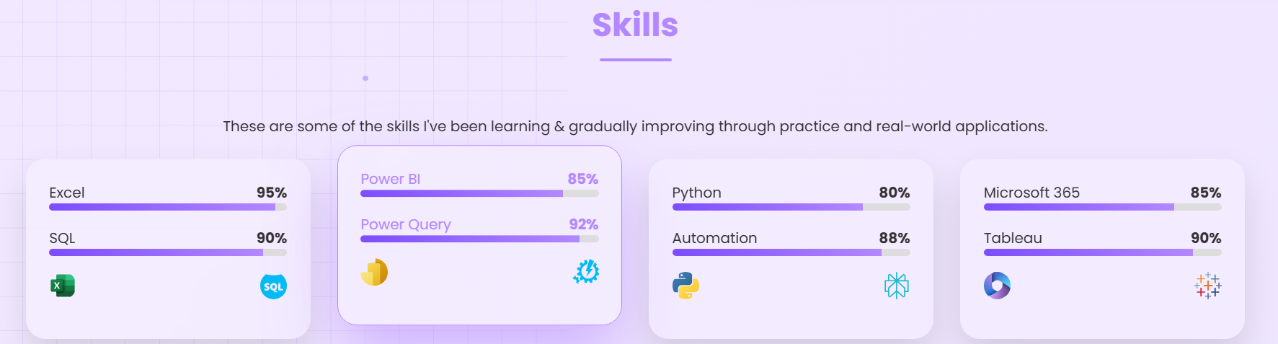
Card Hover Effects
Advanced Card UI Effects
100%
95%
Thin animated borders enhance visual appeal
Soft shadow depth creates realistic effect
90%
90%
Hover changes text & border color to violet
Smooth transitions and interactive feel
Enhances user engagement and overall UI
Glass-style card surface for premium design

Slide 14


Rare Button Effects
Button Interactions
Pressure-based hover animation for realism
Smooth 60° rotation effect on hover
Provides realistic interaction feedback to users
Very uncommon on standard portfolio websites
Enhances user engagement and visual appeal
Adds premium interactive experience

Slide 15
Experience Representaion
Experience
Detailed experience cards for clarity
Professional storytelling of career journey
Honest learning & work highlights
Enhances readability and engagement
Clean zig-zag layout movement (left-right)
Builds trust with transparent experience display
template.wps.com

Slide 16
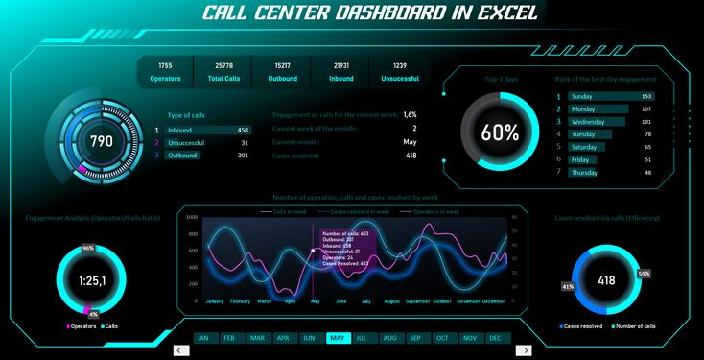
Project Showcase
Project Section
Each project presented in a dedicated card
Clickable project titles for detailed view
Hover text color transitions for interactivity
Skill-specific SVG icons (Excel, Python, SQL)
Clear domain-wise categorization for clarity
Demonstrates real skills and project credibility
4k
120p
600 Mbps
AI

Slide 17

Certification Credibility
Certification
Platform-specific SVG icons (Microsoft, Canva, Google)
Clickable proof links for verification
Visual trust enhancement for recruiters
Clean grid-based layout for readability
Highlights real achievements & skills
Adds professional credibility to portfolio

Slide 18
JAVASCRIPT FEATURES & UI/UX Design
Add A Short Description
UI/UX Design
Dynamic JavaScript Logic
Name typing animation for interactive effect
Clean and eye-friendly website layout
Skills typing animation for visual appeal
No over-crowding of sections or content
Live date & time update dynamically
Elegant spacing & alignment for readability
Smooth scrolling behavior across sections
Premium scroll experience for smooth navigation
Section-based animation logic for storytelling
Focus on user engagement and interaction
Improves professional perception and credibility
Performance-optimized scripts for faster loading

Slide 19
Tools & Technologies Used
Tools & Technologies
01
04
HTML5 for structured content
Bootstrap concepts for responsive design
02
05
CSS3 with advanced animations & glassmorphism
VS Code & GitHub for development & version control
03
06
JavaScript for dynamic and interactive logic
ChatGPT for content generation & logic assistance

Slide 20
Business Problems Solved
Problems Addressed
Credibility
Lack of personal branding platforms online
Limited visibility on LinkedIn and professional networks
Over-dependency on resumes for credibility
Poor skill presentation and recognition
Beginners struggle to showcase talent effectively
Provides a professional platform for personal branding
30%
Branding
LinkedIn
60%
50%
Visibility
30%
template.wps.com

Slide 21
LinkedIn Ready Portfolio
LinkedIn
Credibility
LinkedIn-Ready Portfolio
Improves profile trust and professional perception
Boosts recruiter engagement and visibility
Makes profile stand out among peers
Acts as live proof of skills & projects
Enhances professional networking opportunities
Supports long-term career growth
SLIDE 23 – FUTURE ENHANCEMENTS
LinkedIn

Slide 22

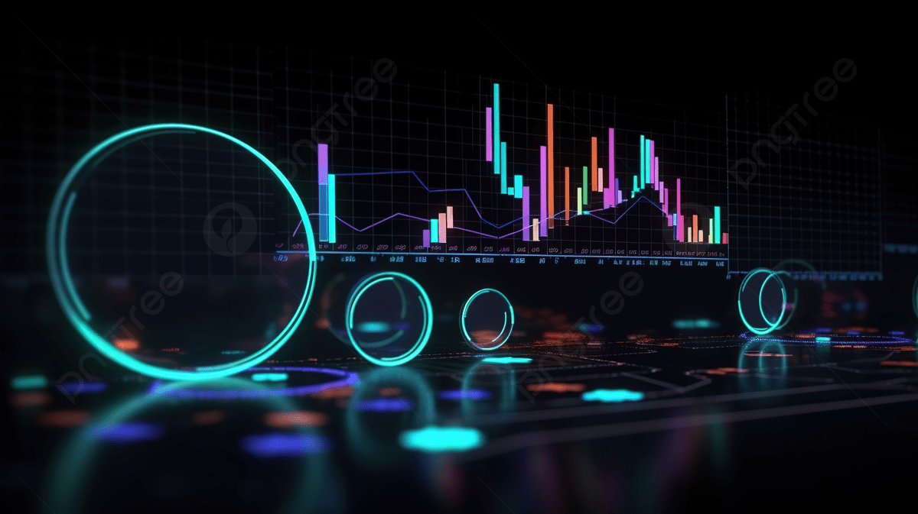


Future Scope
Future Scope
Dark / Light theme toggle option
Performance optimization for faster loading
02
04
Admin panel for content control & updates
Additional interactive features for engagement
01
03
Blog integration for content sharing
Analytics tracking for performance insights

Slide 23

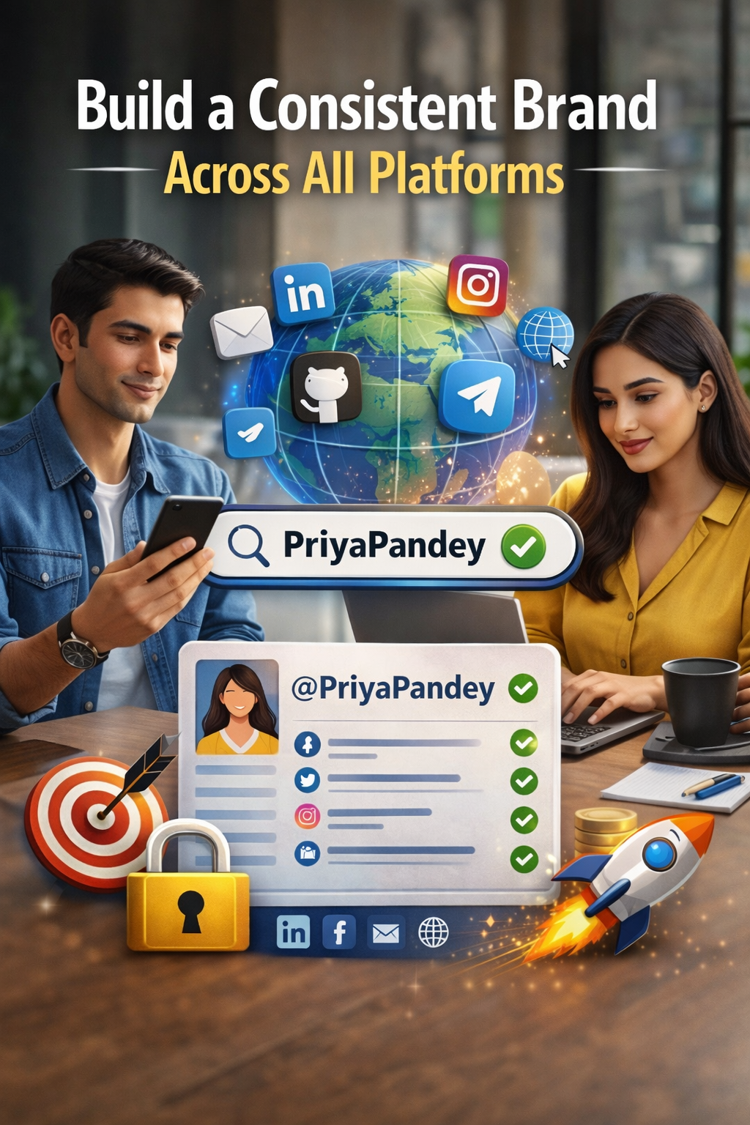
Footer Design & Final Words
Premium Footer & Final Words
Quick links for easy navigation
Privacy Policy for professional trust
Terms & Conditions for website compliance
Hover underline effects for modern design
Elegant industry-level finishing for aesthetics
Completes professional branding of portfolio
Modern, elegant, LinkedIn-ready premium portfolio
Designed for professionals who want to stand out
Enhances credibility and online professional image
Encourages confidence in self-representation
Serves as a personal branding tool
Combines design, interactivity, and storytelling

Slide 24

Premium Footer Experience
Smart Contact Features
Click-to-call opens dial pad automatically
Email opens with prefilled subject & message
No rewriting required for convenience
Rare falling hover animation on icons
Icon rotation on hover for engagement
Makes contacting professional and interactive
Premium
Falling Effect
Automatic

Slide 25

Features
Interactive Features
Embedded Interactive Link – Redirects users to a fully functional website
Premium User Experience – Smooth navigation and clean interface
Feature Showcase – Highlights key properties and functionalities
Professional Presentation – Elegant layout with soft animations
Client-Friendly Design – Readable, engaging, and informative
Immersive Interaction – Modern, high-quality digital experience

Slide 26
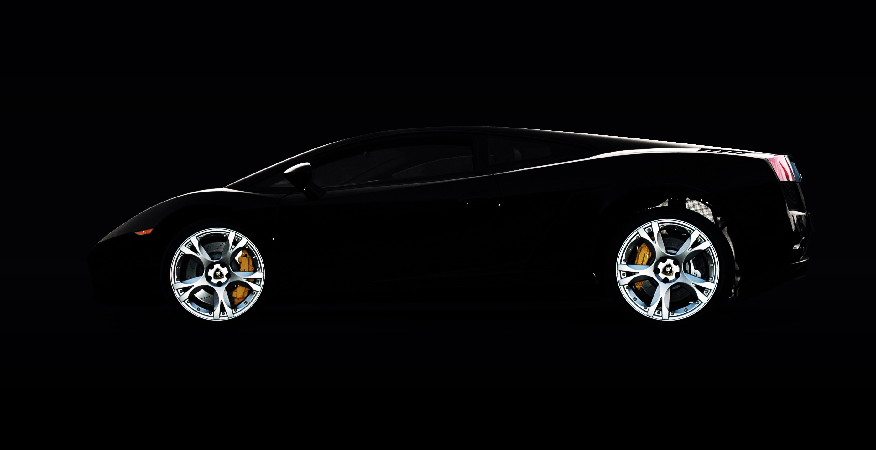
File Architecture
File Architecture
Single-File Architecture – Website built in one HTML file with embedded CSS & JavaScript.
GitHub-Ready Structure – Easy to clone, edit, and push updates.
Client-Editable Design – Changes possible by editing the index.html file.
Minimal Folder Layout – Simple structure with images, policy pages, and README.
Easy Maintenance & Upgrades – Centralized code enables quick updates.
Beginner-Friendly & Professional – Clean, readable code for clients and developers.

Slide 27







Contact me
Connect with me
LinkedIn
Let’s build professional digital identities together
Designed for learners, professionals & future leaders
Collaboration opportunities for portfolio enhancement
Professional networking and skill visibility
Encourages sharing knowledge and projects
Builds a strong online presence
Model Website
Website
LinkedIn
X
GitHub
Mail

Slide 28
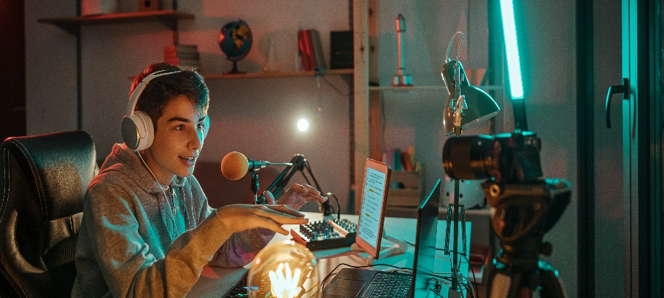
Thank You for Your Time & Attention
Thank You
01
03
Designed to help professionals stand out
LinkedIn and beyond professional showcase
Encourages further interaction & networking
Leaves a lasting positive impression
02
04
Build credibility and represent skills confidently
Modern, elegant, industry-ready portfolio design

Slide 29
THANK YOU FOR WATCHING
Thank you for your attention!
For feedback, improvements, or project collaboration:
LinkedIn
Every great presentation is complete with a great audience and that’s you
2026
Rajeev Dataverse

